Slide 1

SHANGRILA SPA
Presented by: Ctrl+Alt+Elite

Slide 2

AGENDA
INTRODUCTION :MIKARA
PROBLEM STATEMENT :FARNAAZ
LIST OF FEATURES :ASHRAF
CONTEXT LEVEL DIAGRAM :MIKARA
LEVEL 0 DFD :RIKESH
ENTITY RELATIONSHIP DIAGRAM AND GUI :MOHAMMED
CONCLUSION :ASHRAF

Slide 3
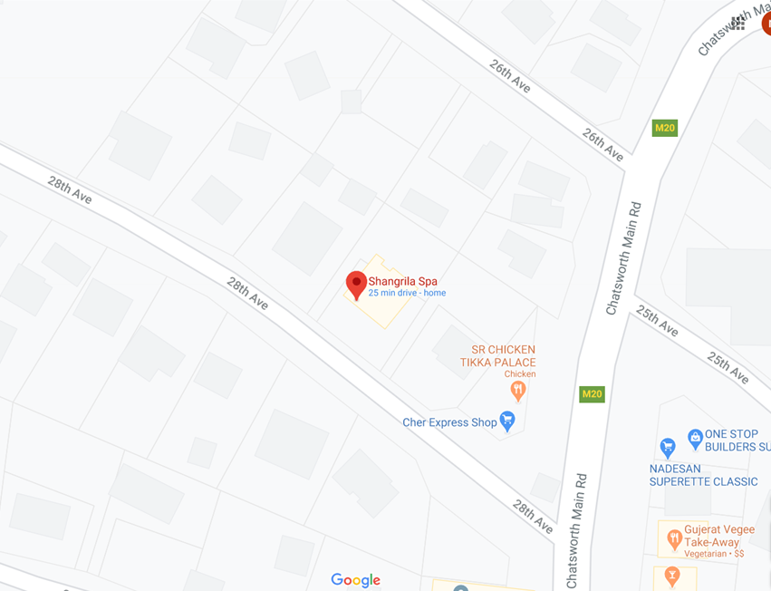
CLIENT INFORMATION
Organisation name : Shangri La Spa
Client Name : Anneline Govender
Telephone No. :061 218 9935
Email address :info@shangrila.co.za
Physical Address : Shop 6, 28th Avenue
Umhlatuzana
4092

Slide 4
CURRENT VS PROPOSED SYSTEM
CURRENT
Appointments recorded manually using the old pen and paper method
System leaves error for multiple clashes of appointment
Prone to human error with regards to staff and customers
PROPOSED
Appointments monitored digitally
System will process and record
Information will be digitally recorded and stored
Appointment scheduling system

Slide 5
OUR SYSTEM
SAVES TIME
HUMAN ERROR REMOVED
IMPROVED DATA SECURITY
LESS MANUAL LABOUR

Slide 6
LIST OF FEATURES
Feature Description | User Profile | Priority (Low/Medium/High) | No of Days to develop
Log into the system | Manager | High | 1
Add new service | Manager | High | 1
Change/cancellation of service | Manager | High | 1
Add new package deals on services | Manager | High | 1
Update discounts on package deals | Manager | High | 1
Provide personal details | Employee | High | 1
Add new staff details | Manager | High | 2
Update staff details | Manager | High | 1
Add customer details | Employee | High | 2
Update customer details | Employee | High | 1
View appointments | Employee | High | 1
Add appointment details | Employee | High | 1
Generate and print invoice | Employee | Low | 1
Search for customer details | Employee | High | 2
View customers | Employee | High | 1
Request customer details | Manager | High | 1
Request staff details | Manager | High | 1
Generate reports | Manager | High | 1
Request reports | Manager | High | 3
Update appointment | Employee | High | 1

Slide 7
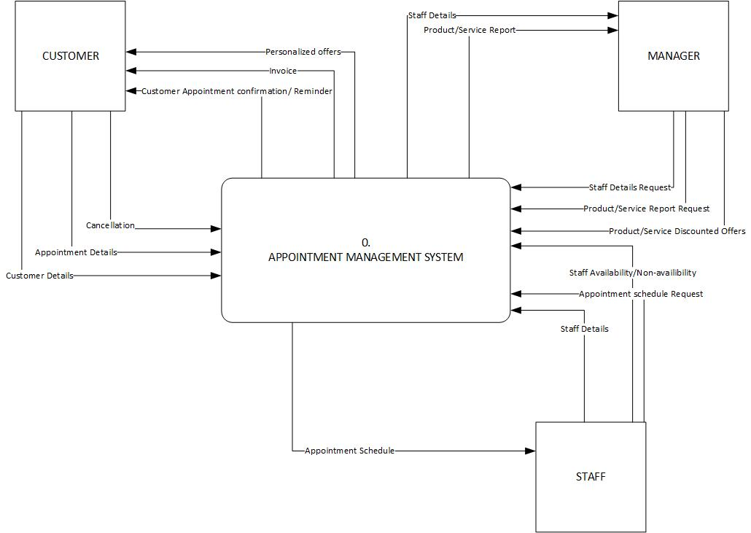
CONTEXT LEVEL DIAGRAM

Slide 8
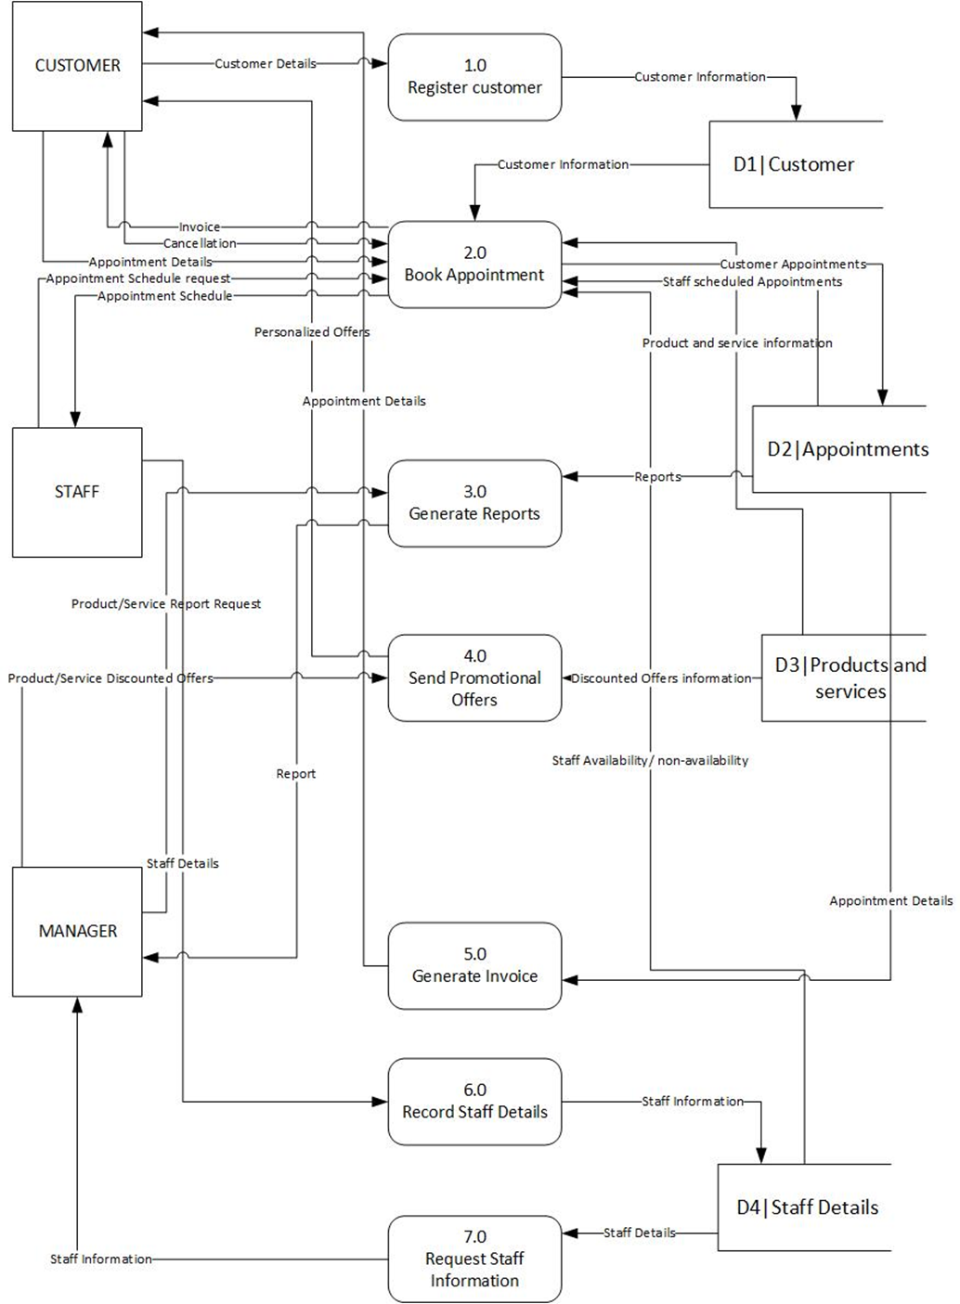
LEVEL 0 DATA FLOW DIAGRAM

Slide 9
PART 1

Slide 10
PART 2

Slide 11
ENTITY RELATIONSHIP DIAGRAMS

Slide 12
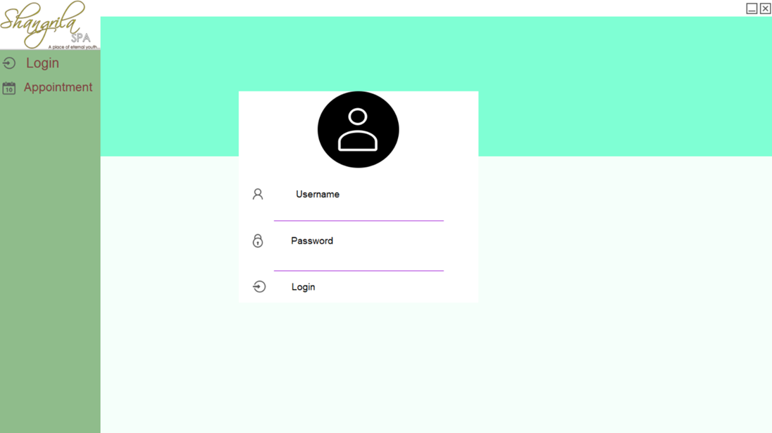

SYSTEM GUI

Slide 13
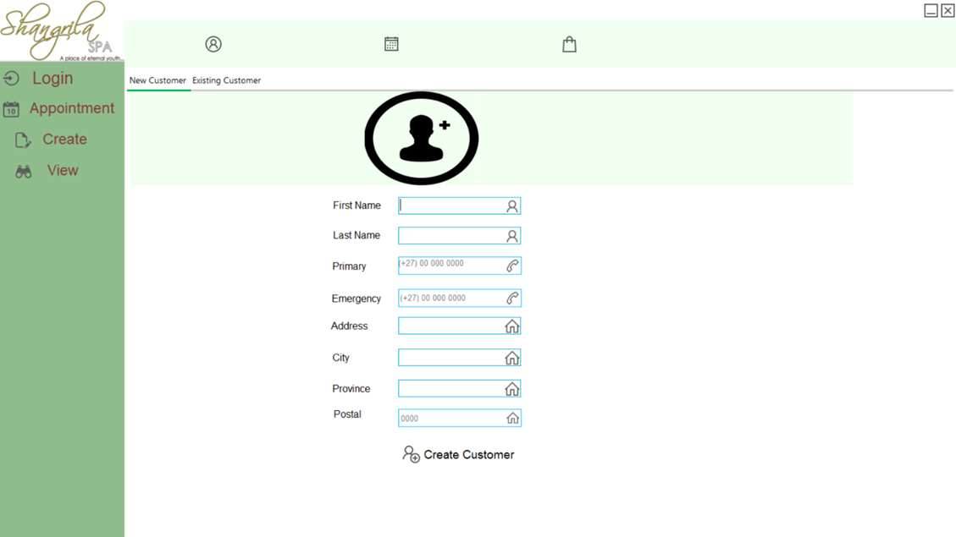
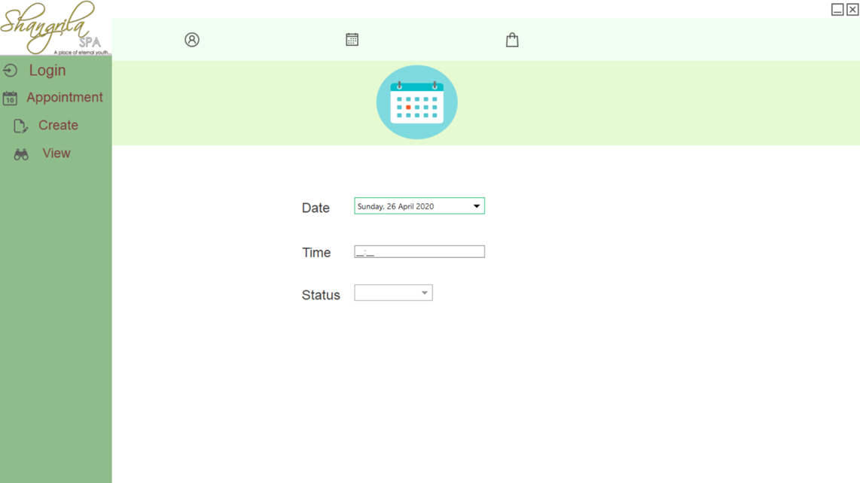
SYSTEM GUI

Slide 14
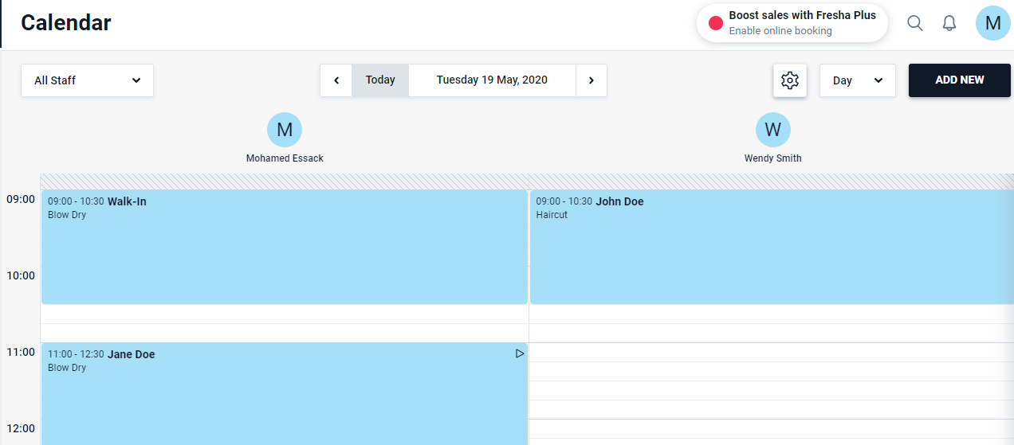
PROPOSED GUI FEATURE
Reference: www.fresha.com/fro-business

Slide 15

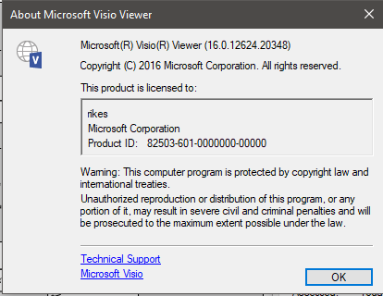
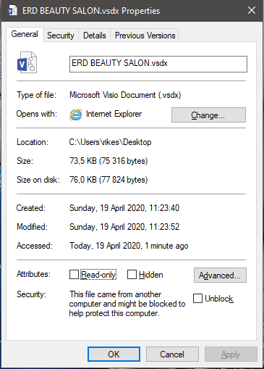
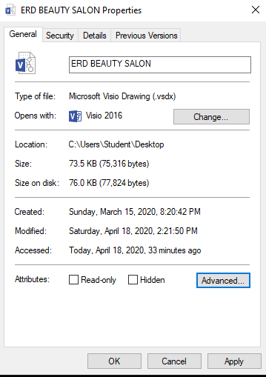
Version Control

Slide 16
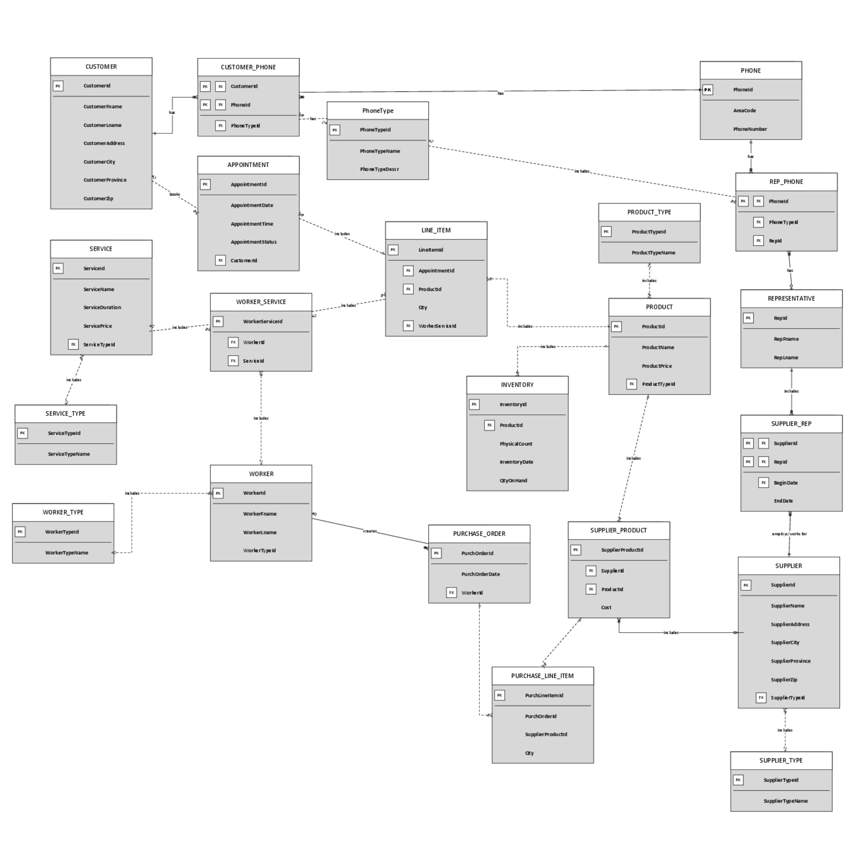
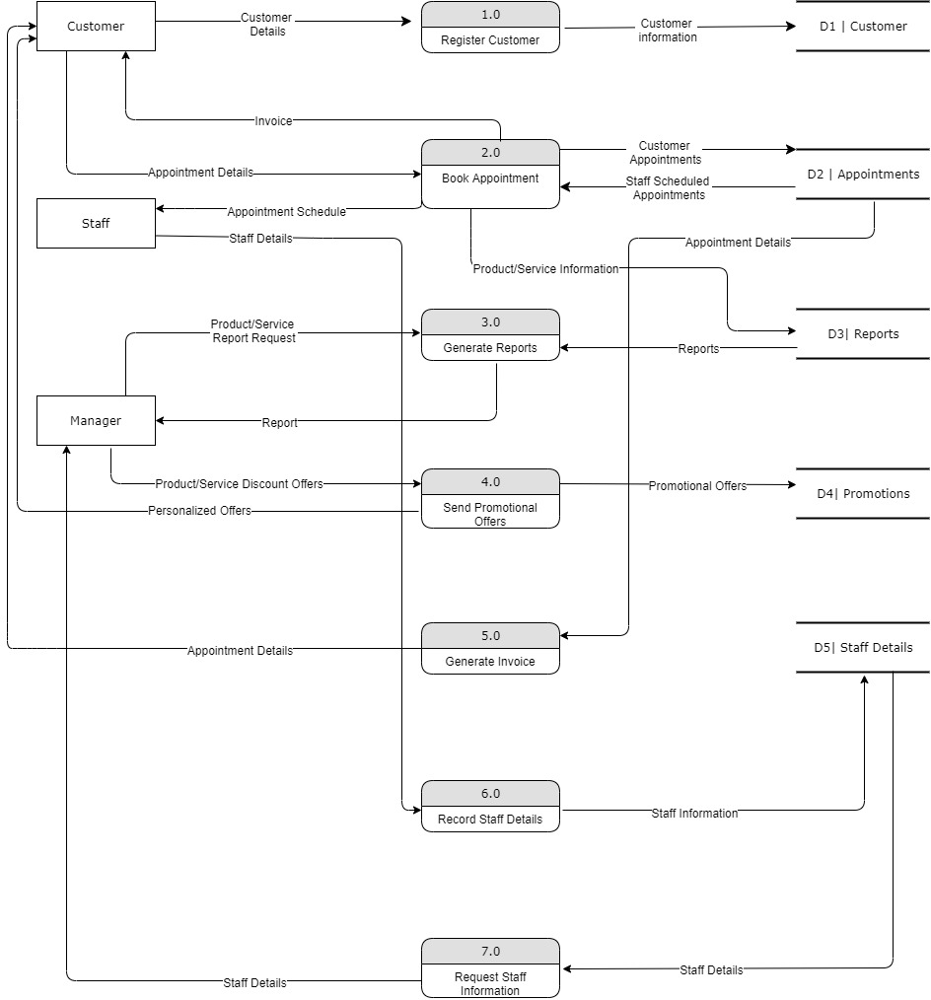
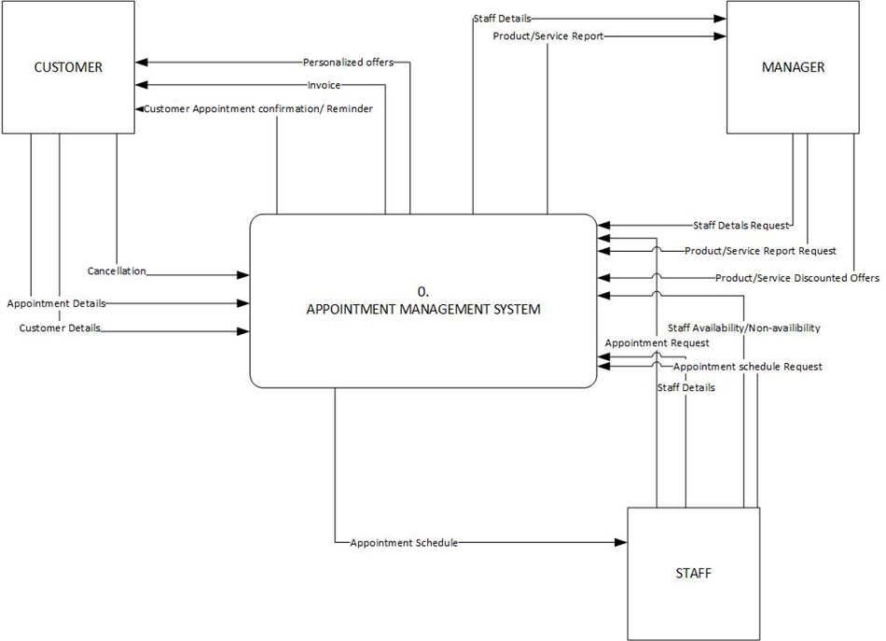
CONCLUSION

